Slide 1
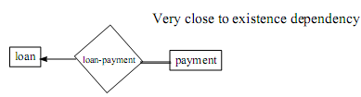
Total Participation
The participation of an entity set E in a relationship R is said to be total if every entity in E participates in at least one relationship in R.
If only some entities in E participate in relationships in R, the participation on entity set E in relationship R is said to be partial.
Notation in E-R diagram: double lines indicate total participation

Slide 2
Extended E-R Features
Specialization
Generalization
Attribute inheritance
Aggregation

Slide 3
Specialization
An entity set may contain subgroupings of entities
Such Entity Set is a high-level entity set that can be broken down into one or more lower-level entity set.
Example:
Course => undergraduate course/ graduate course/ or CMPT/ENG
Account => saving account/ fixed deposit account

Slide 4
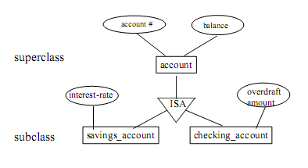
An entity type E1 is a specialization of another entity type E2 if E1 has the same properties of E2 and perhaps even more
E1 IS-A E2
specialization is depicted by a triable labeled ISA.

Slide 5
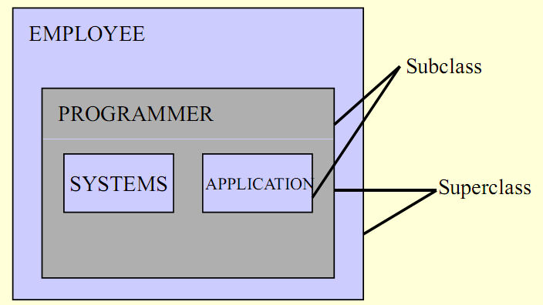
Analogy to super class & sub class
Systems and Application are Subclasses of Programmer

Slide 6
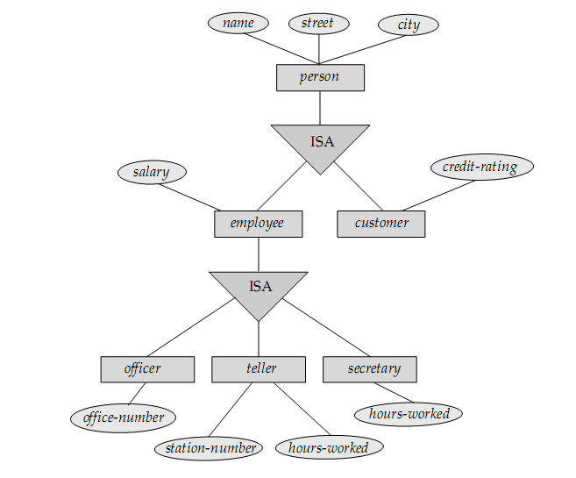

Slide 7
Generalization
Specialization => top-down design
Generalization => bottom-up design
Abstracting the common properties of two or more entities to produce a “higher-level” entity.

Slide 8
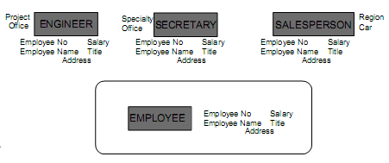
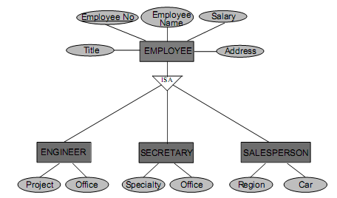

Slide 9
Create Table
CREATE TABLE Persons ( Id int NOT NULL PRIMARY KEY, LastName nvarchar(255) NOT NULL, FirstName nvarchar(255), Address nvarchar(255), City nvarchar(255) )
NOT NULL constraint enforces a column to NOT accept NULL values.

Slide 10
Primary key contraint name (Multiple columns)
CREATE TABLE Persons ( Id int NOT NULL, LastName varchar(255) NOT NULL, FirstName varchar(255), Address varchar(255), City varchar(255), CONSTRAINT pk_PersonID PRIMARY KEY (Id,LastName) )

Slide 11
SQL PRIMARY KEY Constraint on ALTER TABLE
ALTER TABLE Persons ADD PRIMARY KEY (Id)
ALTER TABLE Persons ADD CONSTRAINT pk_PersonID PRIMARY KEY (Id,LastName)

Slide 12
DROP a PRIMARY KEY Constraint
ALTER TABLE Persons DROP CONSTRAINT pk_PersonID

Slide 13
Foreign Key
CREATE TABLE Orders ( Id int NOT NULL, OrderNo int NOT NULL, PId int, PRIMARY KEY (Id), CONSTRAINT fk_PerOrders FOREIGN KEY (PId) REFERENCES Persons(Id) )

Slide 14
CREATE TABLE Orders ( Id int NOT NULL PRIMARY KEY, OrderNo int NOT NULL, PId int FOREIGN KEY REFERENCES Persons(Id) )

Slide 15
ALTER TABLE Orders ADD CONSTRAINT fk_PerOrders FOREIGN KEY (PId) REFERENCES Persons(Id)
ALTER TABLE Orders DROP CONSTRAINT fk_PerOrders

Slide 16
Sys object
sp_help “Table-Name”
SELECT * FROM sys.key_constraints
SELECT * FROM sys.tables
SELECT * FROM sys.key_constraints
WHERE [type] = 'PK‘ AND [parent_object_id] = Object_id('dbo.iProductCategory');

Slide 17
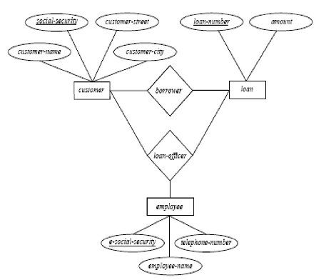
Aggregation

Slide 18
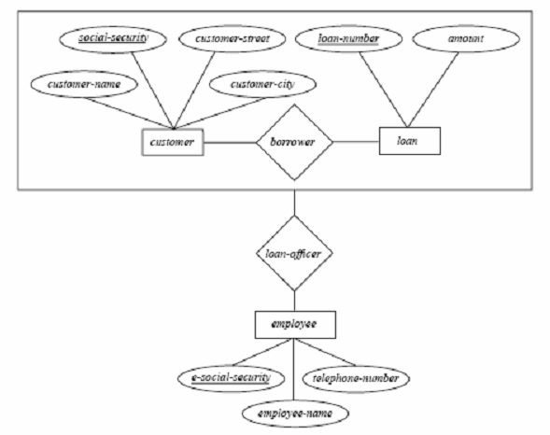
Relationship sets borrower and loan-officer represent the same information
- Eliminate this redundancy via aggregation as shown in Figure

Slide 19
Without introducing redundancy, the above diagram represents that:
A customer takes out a loan
An employee may be a loan officer for a customer-loan pair
Points in Aggregation
– Treat relationship as an abstract entity.
– Allows relationships between relationships.
– Abstraction of relationship into new entity.

Slide 20
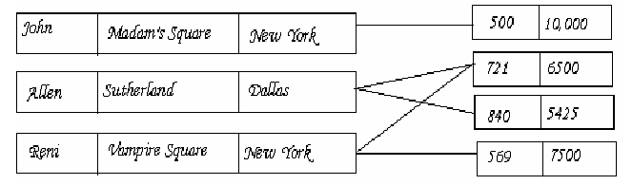
Network Model
Data are represented by collections of records.
Relationships among data are represented by links.
Organization is that of an arbitrary graph and represented by Network diagram.

Slide 21
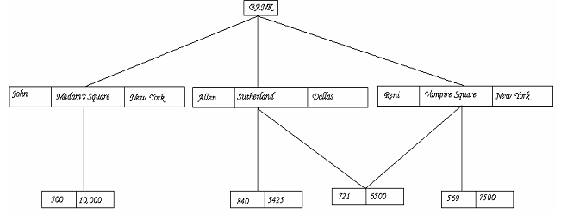
The Hierarchical Model
Similar to the network model and the concepts are derived from the earlier systems. (older models)
Organization of the records is as a collection of trees, rather than arbitrary graphs.

Slide 22
In the hierarchical model, a Schema is represented by a Hierarchical Diagram
One record type, called Root, does not participate as a child record type.
Every record type except the root participates as a child record type in exactly one type.
Leaf is a record that does not participate in any record types.
A record can act as a Parent for any number of records.

Slide 23
Class work
Construct an E-R diagram for a car-insurance company whose customers own one or more cars each. Each car has associated with it zero to any number of recorded accidents.
Construct an E-R diagram for a hospital with a set of patients and a set of medical doctors. Associate with each patient a log of the various tests and examinations conducted.

Slide 24
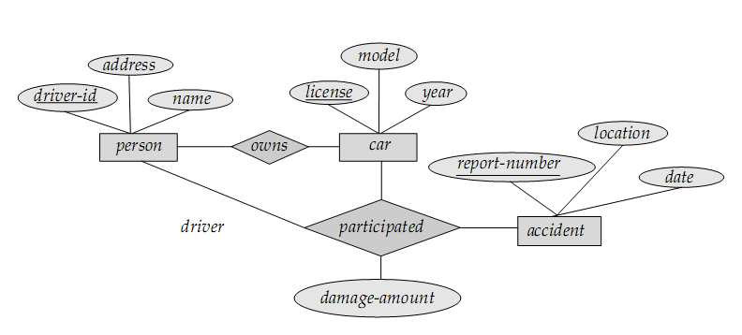
Insurance company

Slide 25
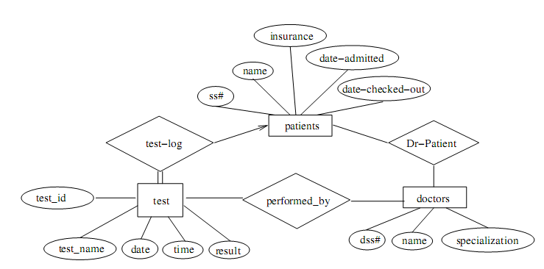
Hospital

